Slide 1
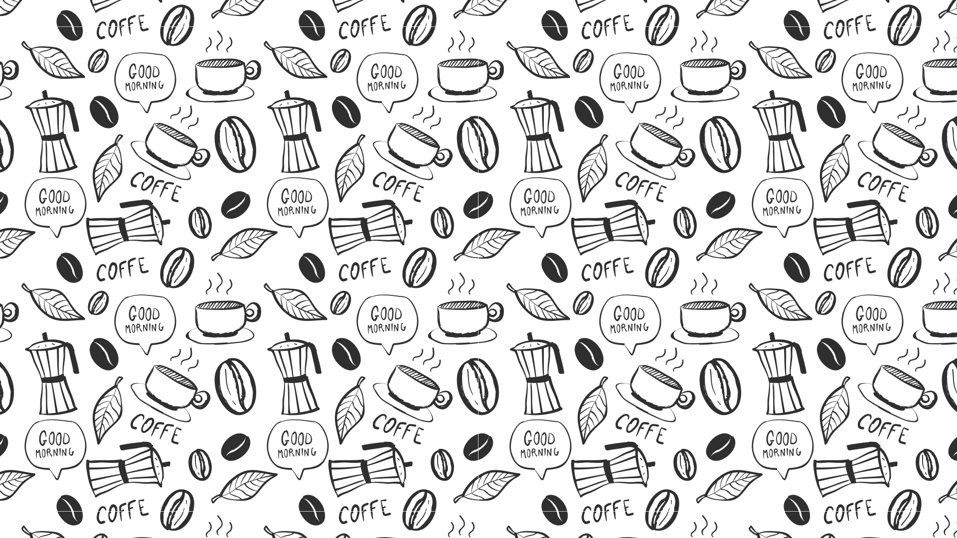
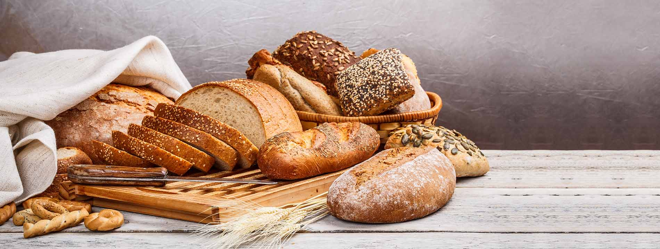
Bundles of Dough
Data Analysis

Slide 2
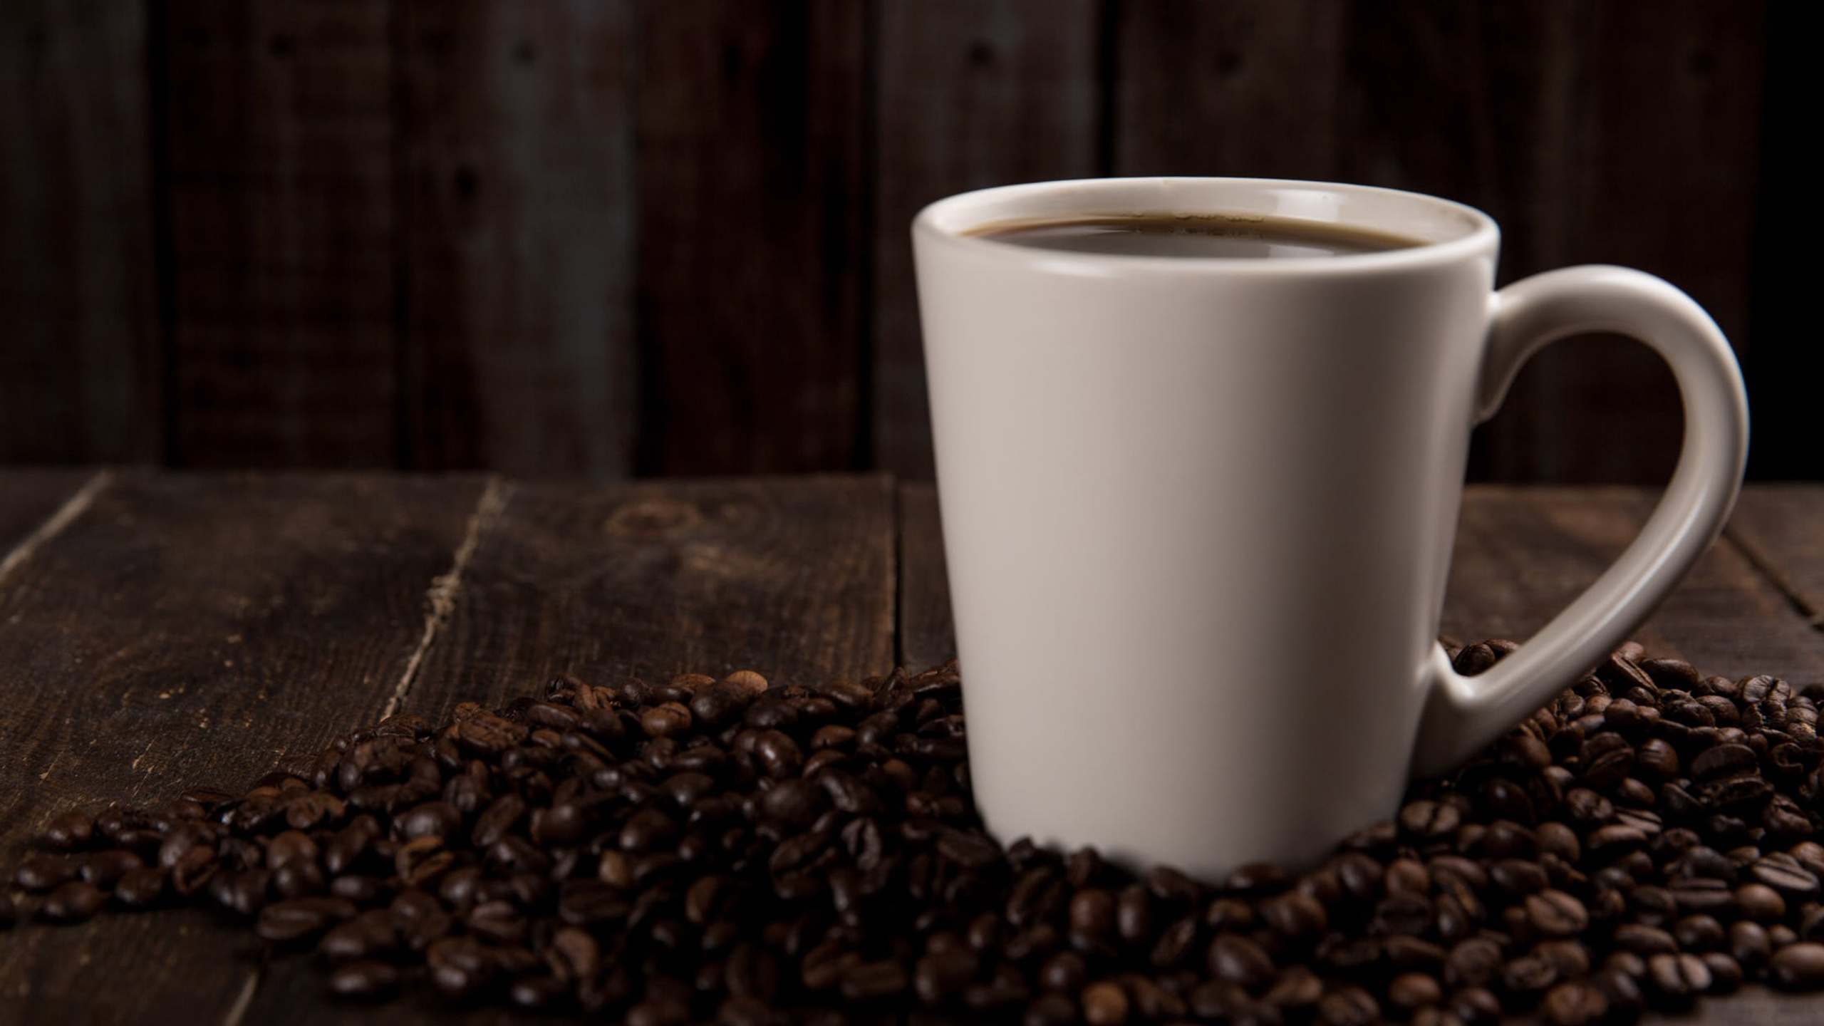
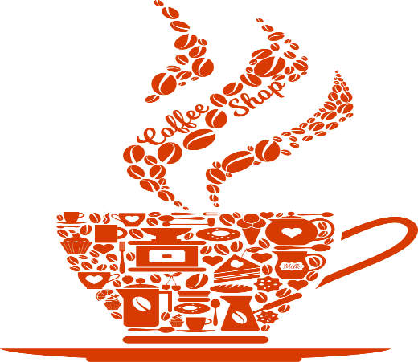
OUR BIG IDEA
Bundles of Dough’s mission is to highlight the most commonly purchased items in a given bakery, both on any given day, and within the context of several months.

Slide 3
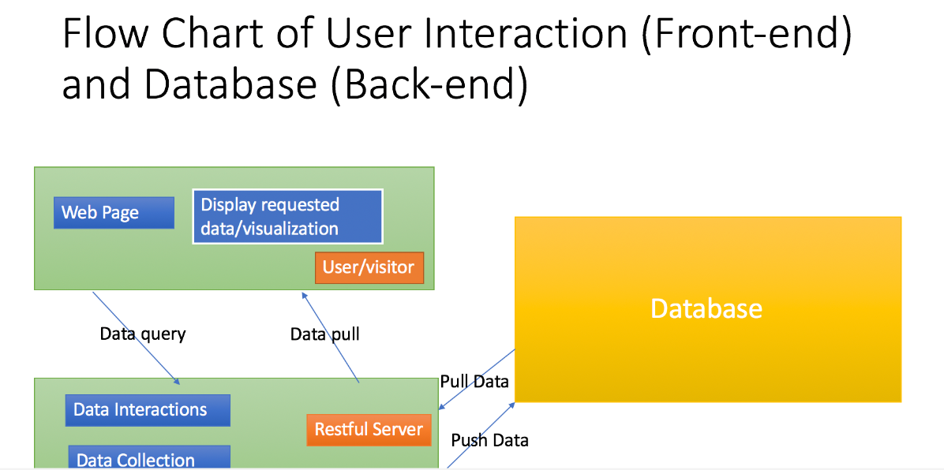
Bundles of Dough Flow Chart

Slide 4
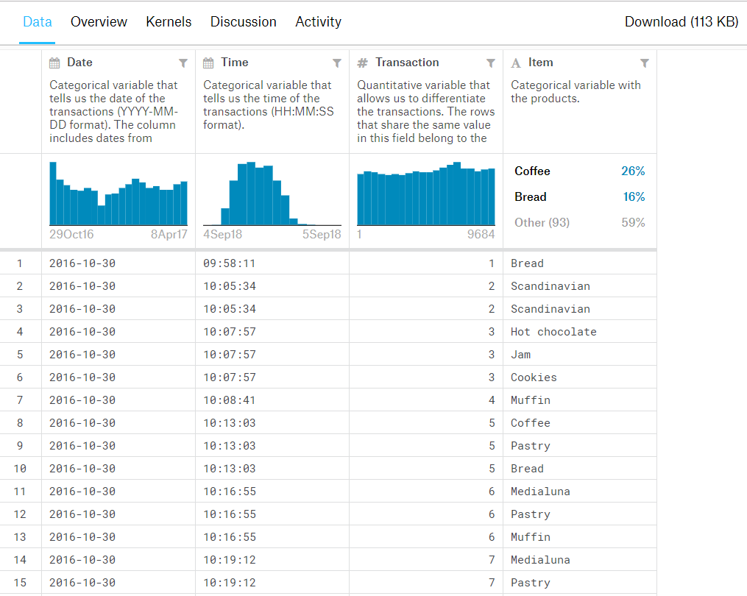
Snippet of Raw Data

Slide 5
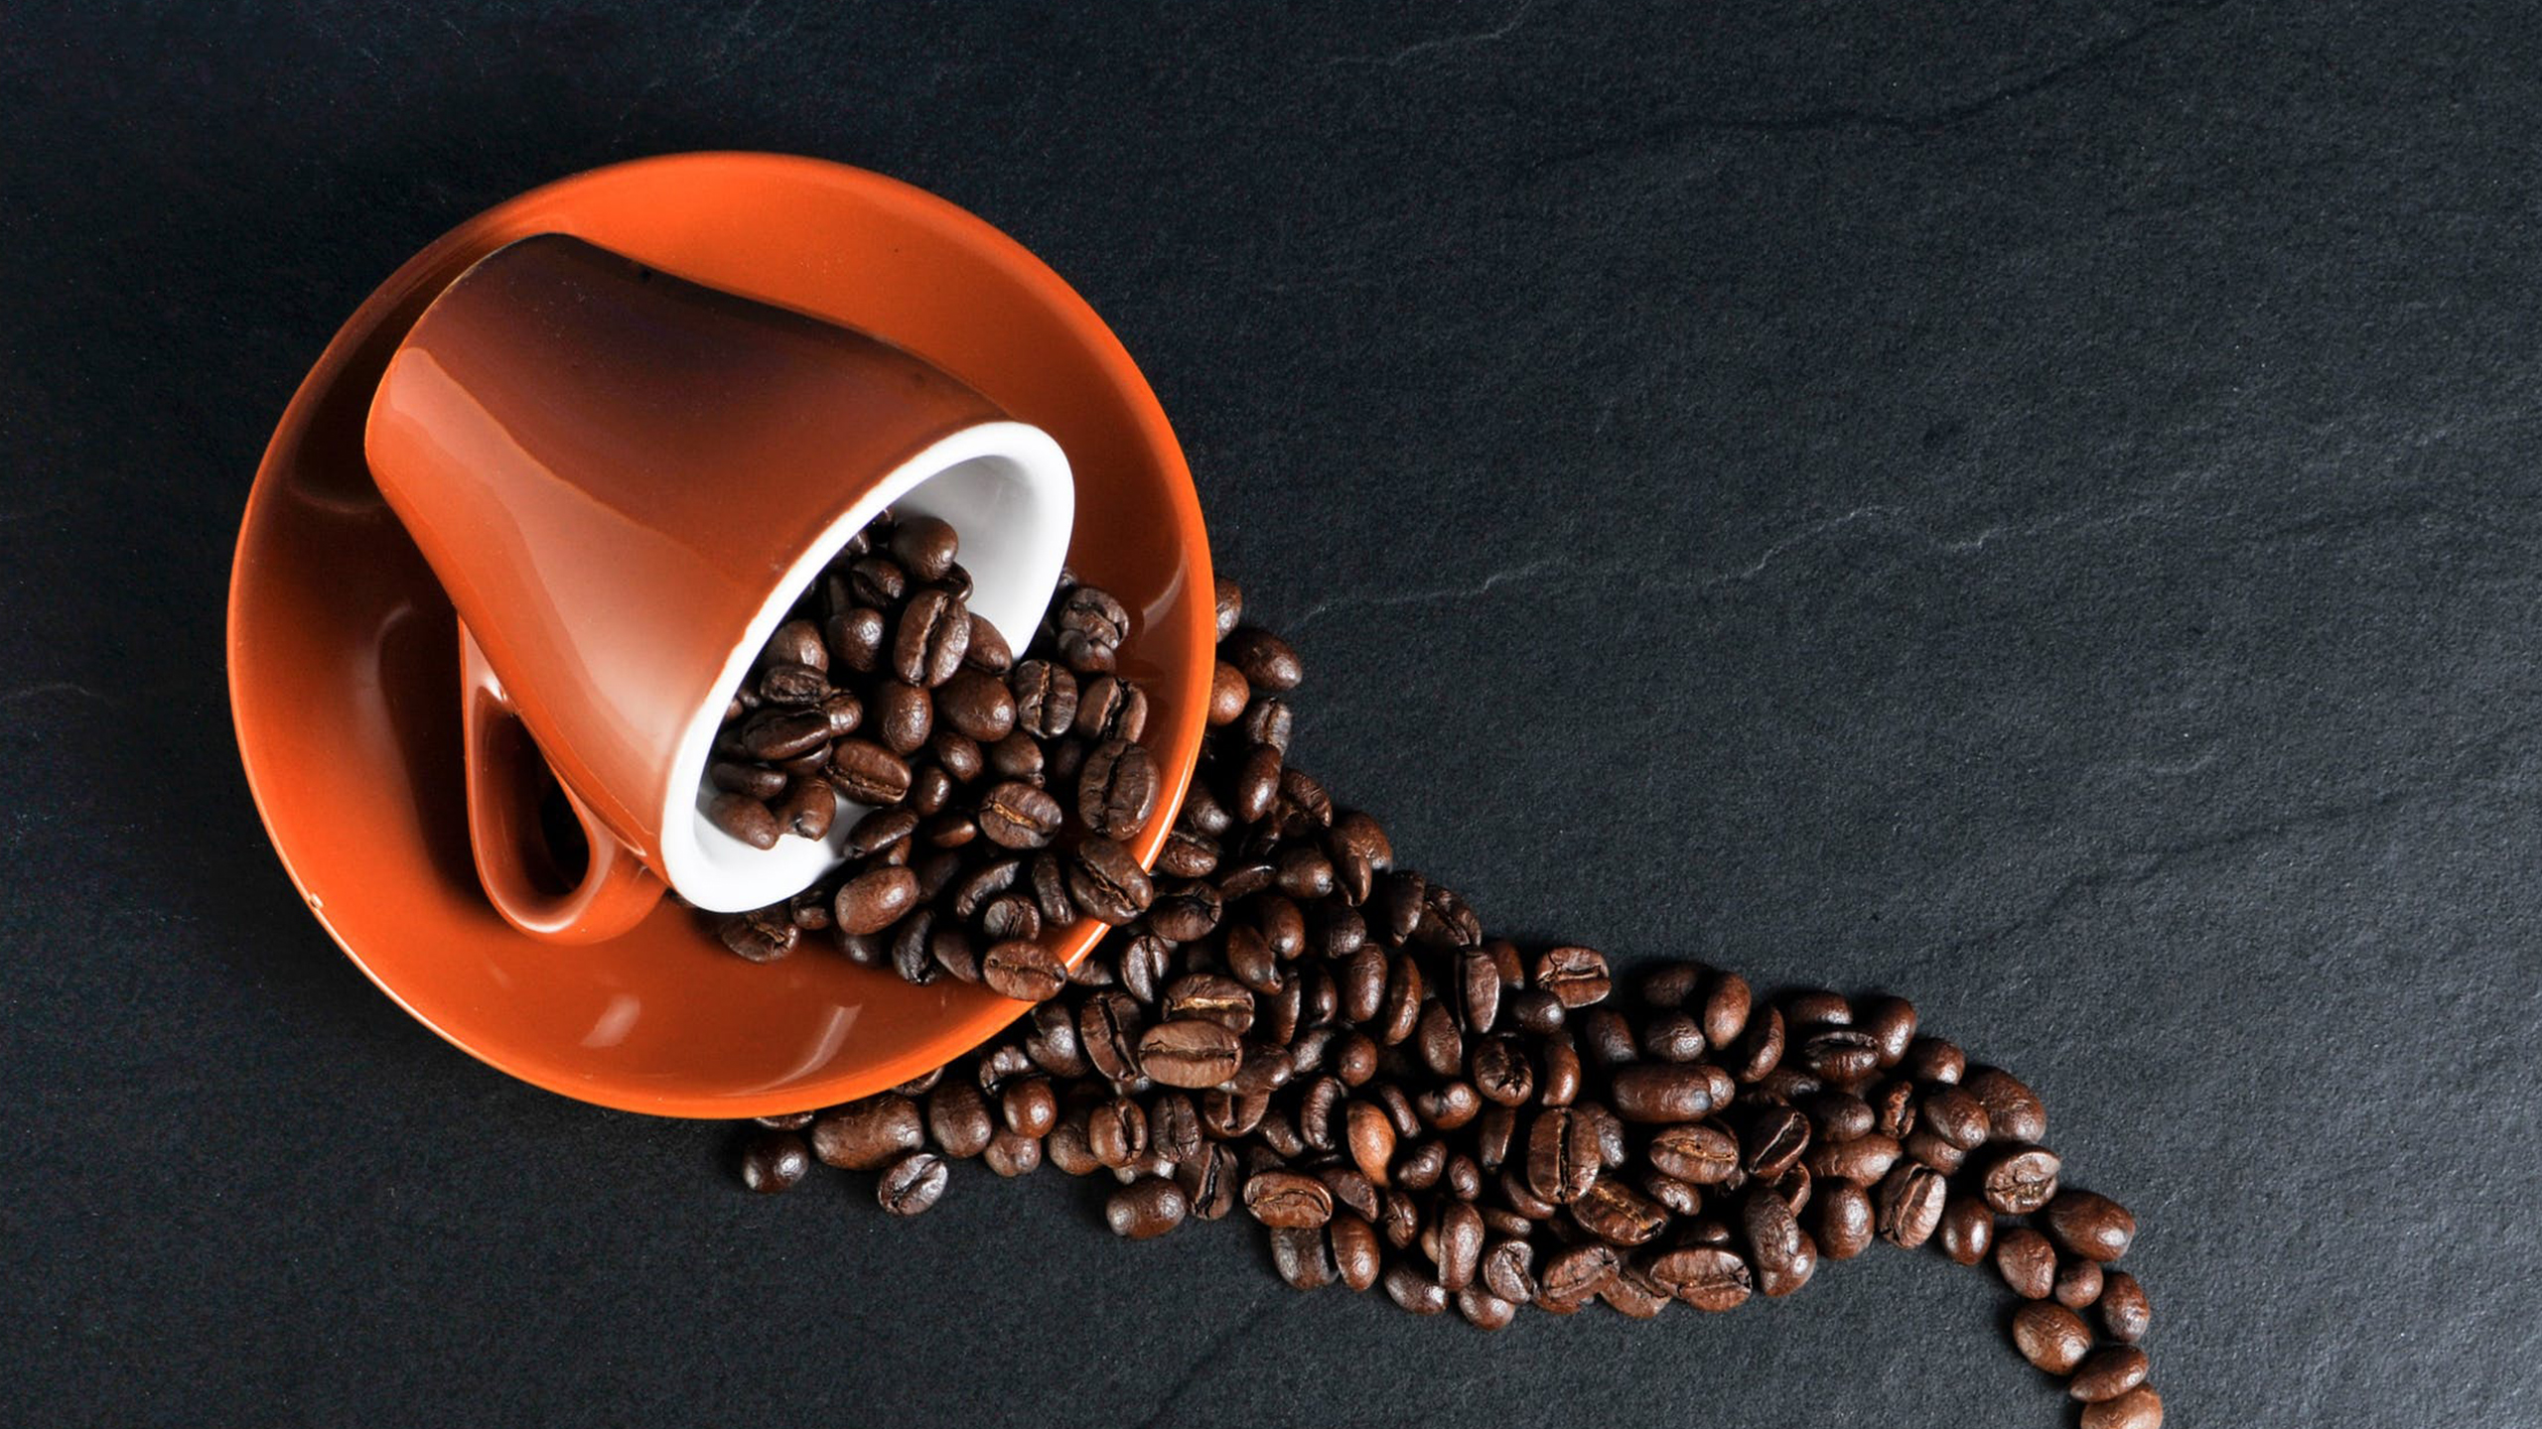
The Data Set
According to the dataset explanation (found at https://www.kaggle.com/xvivancos/market-basket-analysis/data) this data belongs to a bakery called "The Bread Basket", located in Edinburgh, Scotland. This bakery presents a refreshing offer of Argentine and Spanish products. We used this dataset to perform a modeling technique known as Market Basket Analysis. This is based on the idea that one can predict purchasing patterns within items, which is what makes it popular in the field of retail and commerce. This form of analysis helps many forms of businesses understand behavioral patterns and purchase patterns. The idea is to find the link between purchased items. For example, if someone purchases Item1, how likely are they to then also purchase Item2? The answer to this can be found with the application of the Apriori Algorithm.

Slide 6
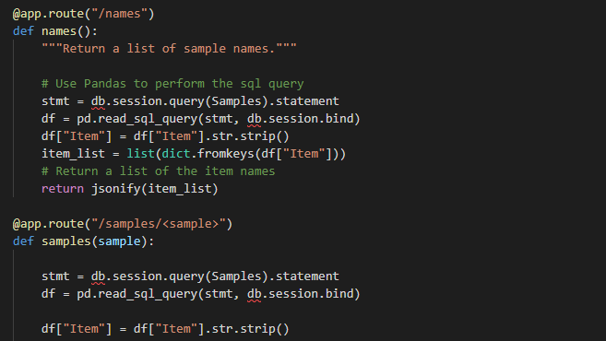
Flask

Slide 7
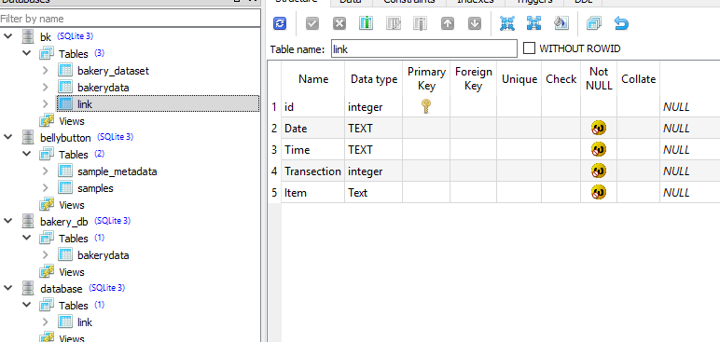
SQLITE

Slide 8
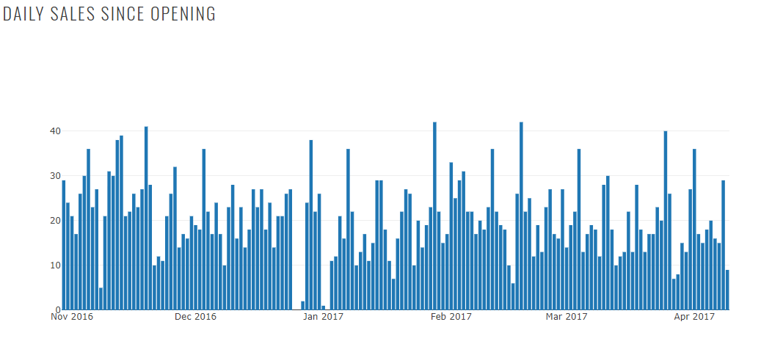
Graphs Time Series

Slide 9
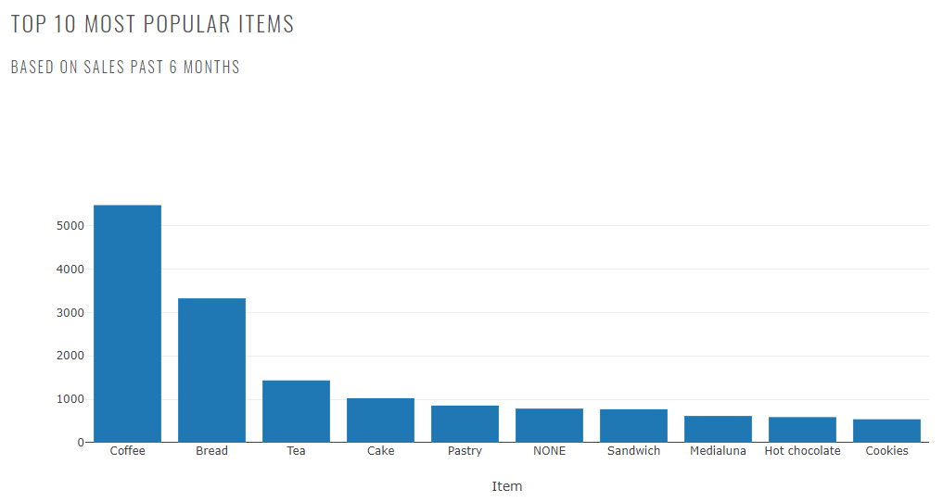
Top 10

Slide 10
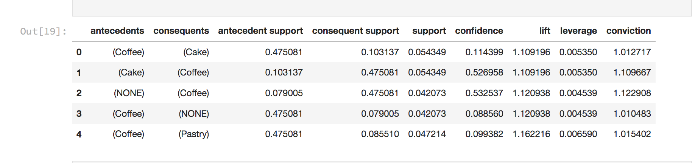
Used mlxtrend library, which is usually used for Shopping Basket Analysis to predict existing relations between various Item purchased

Slide 11

THANK YOU!
Any Questions???
Andrew, Ava, Ghassan & Nikki
anavghni@gmail.com
867-5309

